Slide 1
ADS-B and Transponders
A Quick and dirty overview

Slide 2
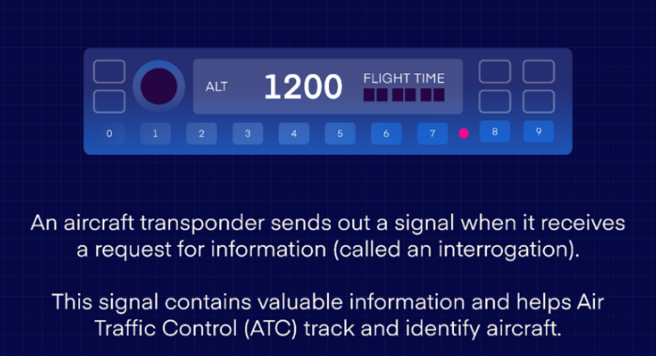
What is a transponder?

Slide 3
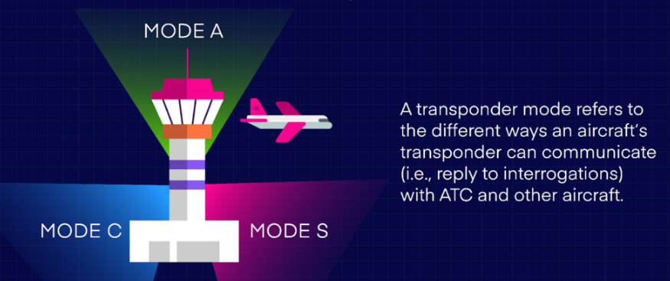
What is a transponder mode?

Slide 4
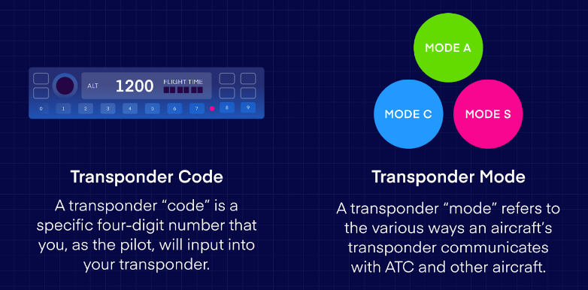
Transponders: codes vs. modes

Slide 5
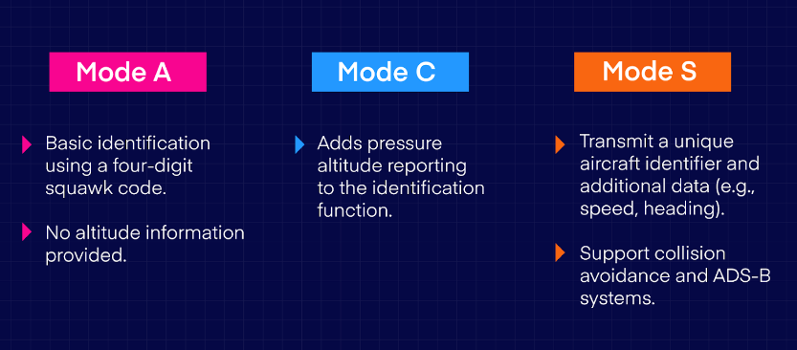
Three transponder modes

Slide 6
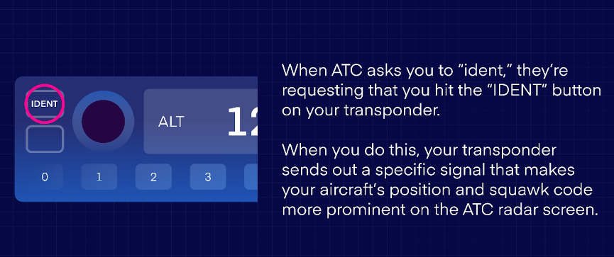
What is IDENT ??

Slide 7


